Slide 1
Paternally inherited cis-regulatory structural variants are associated with Autism
Danny Antaki, Sebat Lab
Biomedical Sciences Graduate Program
Department of Psychiatry
University of California, San Diego
May 17, 2018

Slide 2
Outline
Background
History of Autism Genetics
SV²: genotyping SVs with machine learning
Controlling for Genotyping Errors
Paternally inherited cis-regulatory variants and Autism

Slide 3

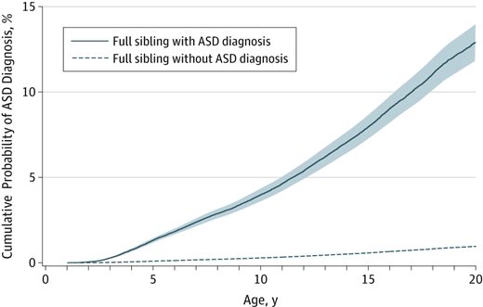
Autism is a heterogeneous neurodevelopmental disorder
Impaired social interaction and restricted behavior
1% Prevalence, 4:1 Male:Female
Sporadic or familial
Siblings have increased risk
Genetic liability is significant
MZ twin concordance 30-99% (0.6-0.8 heritability)
Wikipedia Commons
Sandin, Sven, et al. Jama 2014
Notes:
How presentation will benefit audience: Adult learners are more interested in a subject if they know how or why it is important to them.
Presenter’s level of expertise in the subject: Briefly state your credentials in this area, or explain why participants should listen to you.

Slide 4
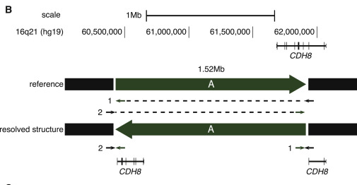
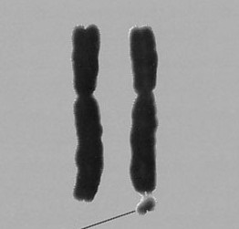
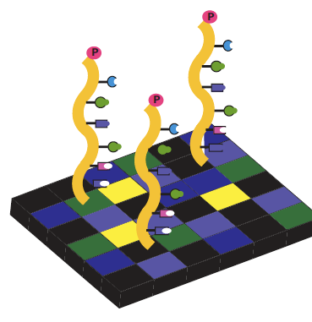
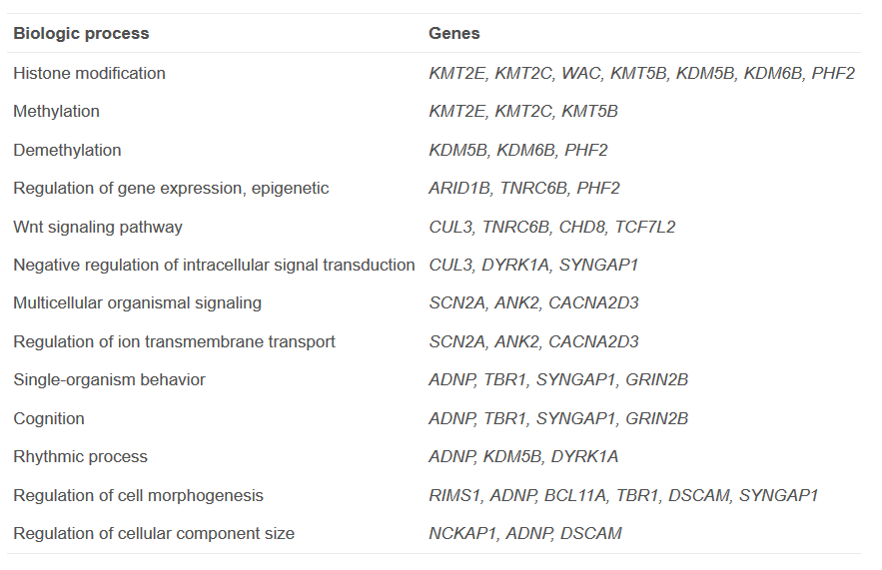
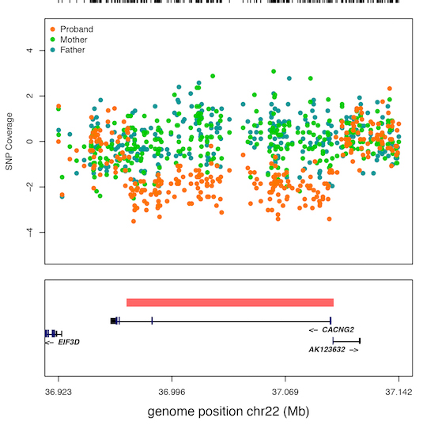
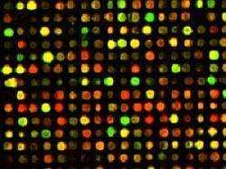
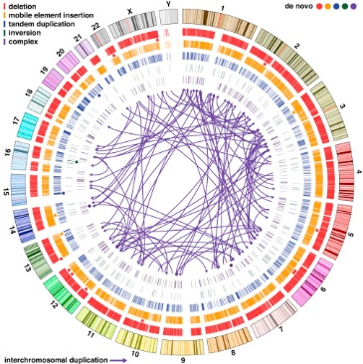
de novo inversion disrupts CDH8
15-25% of cases have a casual variant
~60-100 genes associated with ASD
Exome studies found loss of function and missense SNPs+INDELs (1-50bp)
First genetic associations were
microscopic structural changes
(>10Mb)
de novo deletion, spontaneous mutation in child
1960’S
1970’S
1980’S
1990’S
2000’S
2010’S
Brandler, W. M.*, Antaki D.*, Gujral M.* et al. AJHG 2016
Microarrarys found sub-microscopic structural changes
(100kb-10Mb)
Whole genome sequencing resolved complex de novo structural changes (50bp-10Mb)
Ramaswami G., Geschwind D. Handbook of Clinical Neurology 2018
Notes:
How presentation will benefit audience: Adult learners are more interested in a subject if they know how or why it is important to them.
Presenter’s level of expertise in the subject: Briefly state your credentials in this area, or explain why participants should listen to you.

Slide 5
Rationale for Structural Variants
Classes of Sequence Mutations
SNP: 1bp
INDEL: 2bp-49bp
SV: >50bp
Reference
GATCGATC
GAGCGATC
GAT--CGATC
GAGAG-GATC
Mutation
Functional impact
Potentially more damaging
False Discovery Rate
SV <10kb
Enriched for false positives
SVs are more likely to elicit a functional change but detection carries the cost of a high FDR
Notes:
Example objectives
At the end of this lesson, you will be able to:
Save files to the team Web server.
Move files to different locations on the team Web server.
Share files on the team Web server.

Slide 6
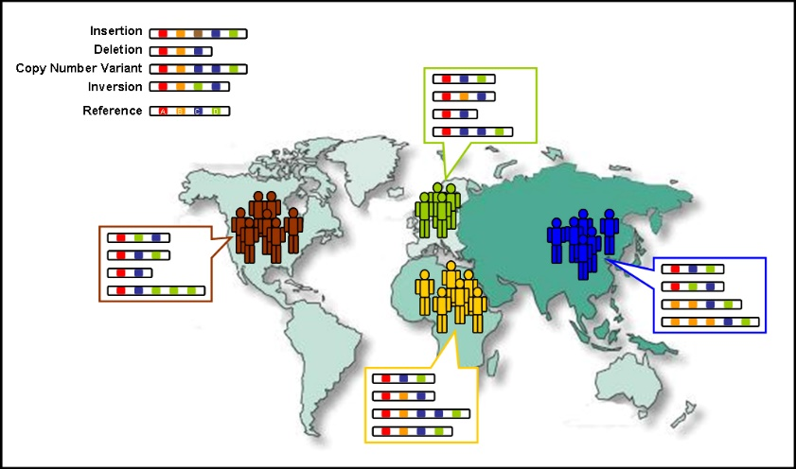
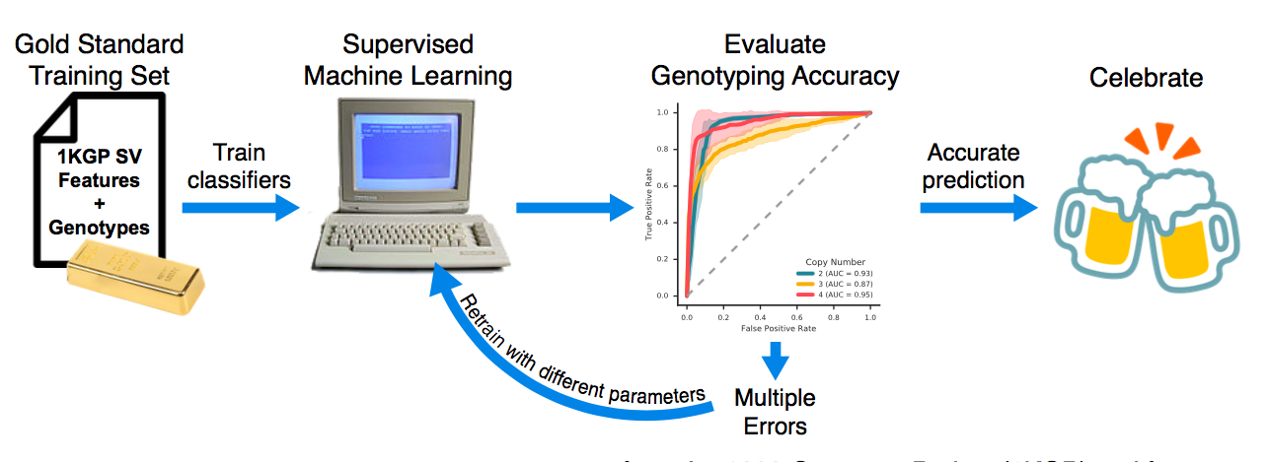
Detecting genotyping errors with machine learning
Training set: 1000 Genomes
SVs from phase 3 release
High coverage WGS (n=27), Low coverage WGS (n=2,494)
Homozygous Deletion: 0 copies
Heterozygous Deletion: 1 copy
Homozygous neutral : 2 copies
Heterozygous Duplication : 3 copies
Homozygous Duplication : 4 copies
Notes:
Example objectives
At the end of this lesson, you will be able to:
Save files to the team Web server.
Move files to different locations on the team Web server.
Share files on the team Web server.

Slide 7
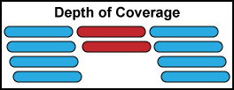
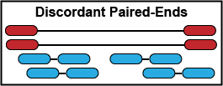
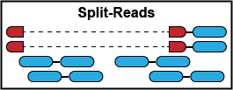
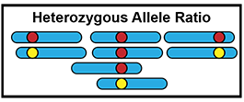
Features of SV in Next-Gen Sequencing
Coverage: Number of reads spanning the SV
Discordant Paired-Ends: abnormal insert sizes
Split-Reads: reads that span SV breakpoints
Heterozygous Allele Ratio:
Duplications only

Slide 8
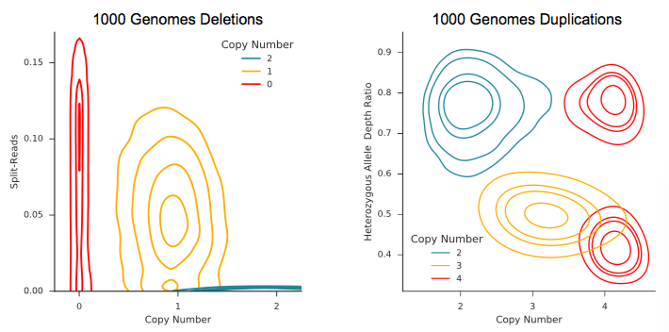
Visualizing Training Features
Deletions < 1000bp classifier. Copy Number is a function of coverage.
Duplications with heterozygous allele ratio features.
Aa
AAaa
AAa
AAAa
The distribution of the data are clearly non-linear. Support Vector Machine classifier with a Radial Basis Function Kernel can take advantage of the non-linearity

Slide 9
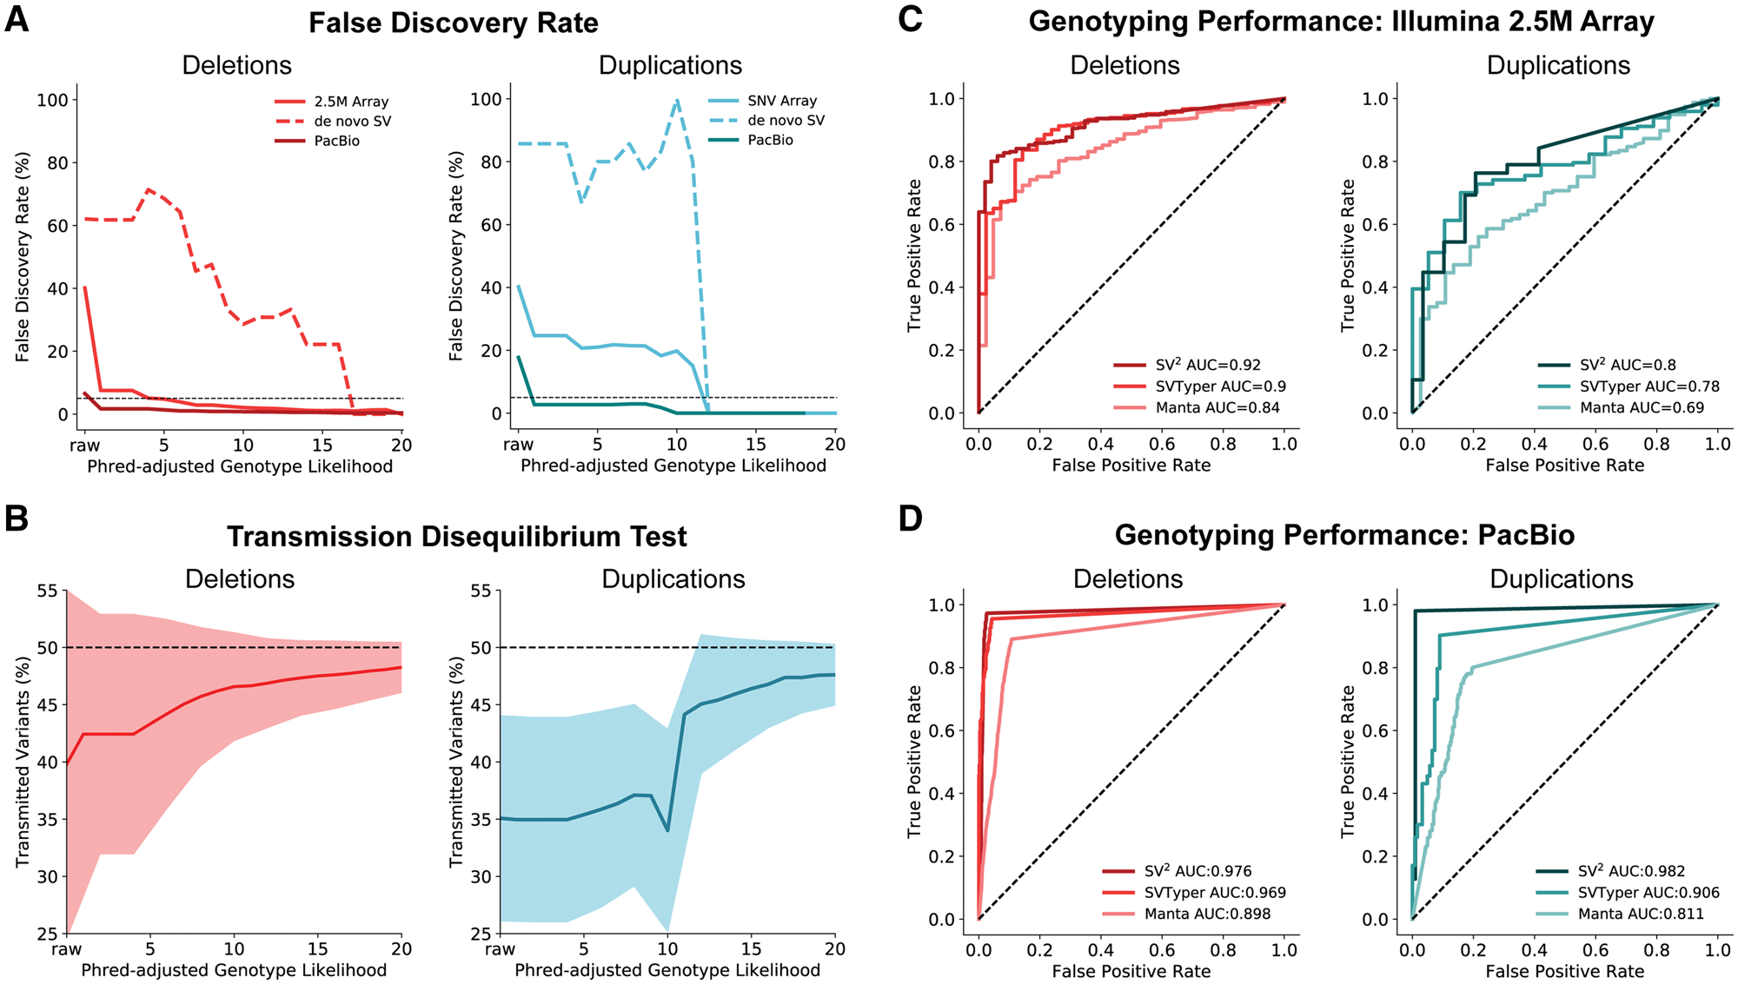
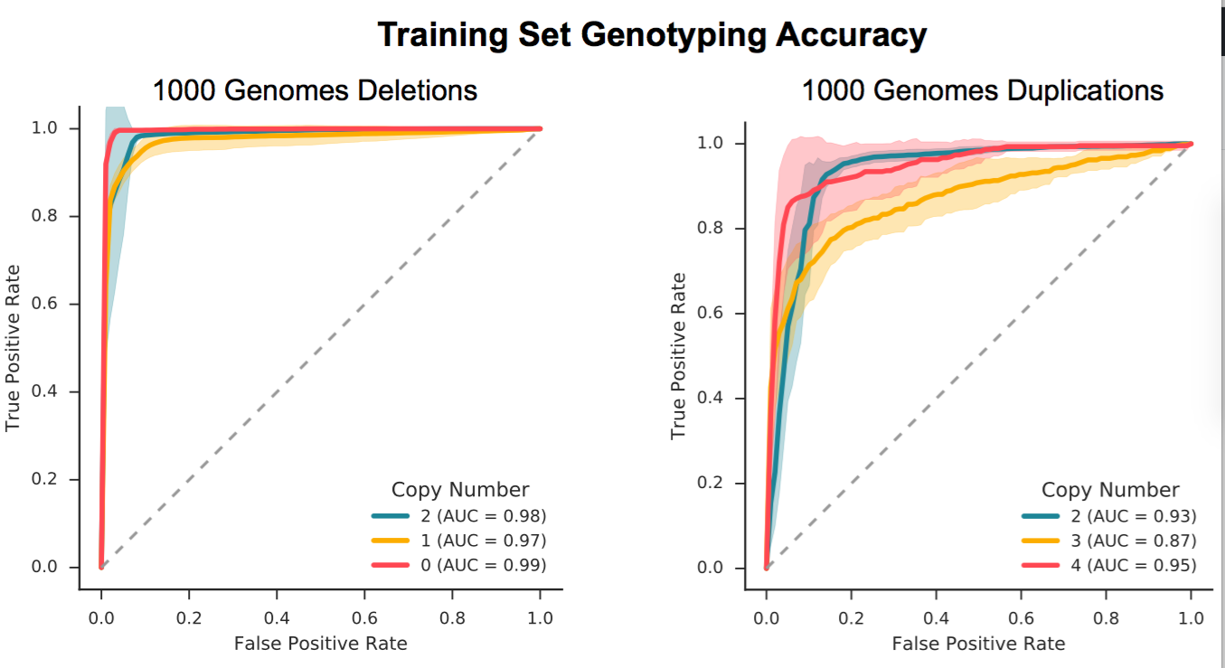
Genotyping Performance
Orthogonal validation:
Microarray: N=57
SVToolkit validated WGS SV genotypes
PacBio SMRT: N=9
Split-reads or CIGAR string
7-fold cross validation of the training set.
Transmission Disequilibrium Test
deviations from the expected transmission rate (50%) are due to genotyping errors
False positives in parents
False negatives in offspring

Slide 10

Comparing SV² to other probabilistic models
SVTyper and Manta utilize paired-end features and probabilistic models
SV² leverages paired-end, coverage, and heterozygous allele ratios and was trained on real data

Slide 11
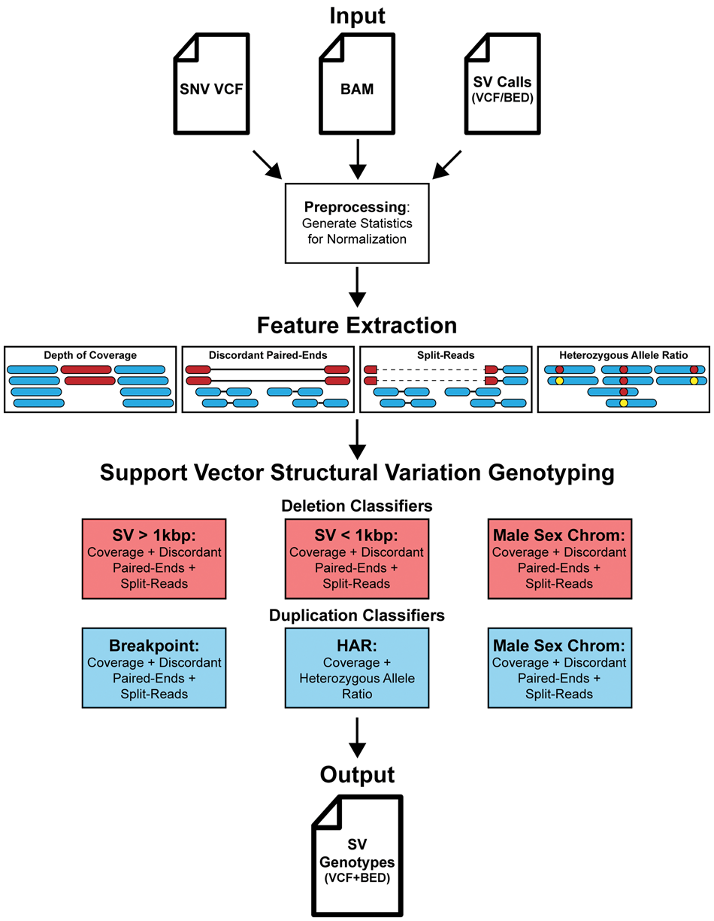

SV² Overview
Low FDR
1.2% Deletions
4.4% Duplications
Low Genotyping Error rates
~48% Transmission Rates
Outperforms other methods
Freely available on github
Python/Cython
github.com/dantaki/SV2
Antaki D. et al. Bioinformatics 2017

Slide 12
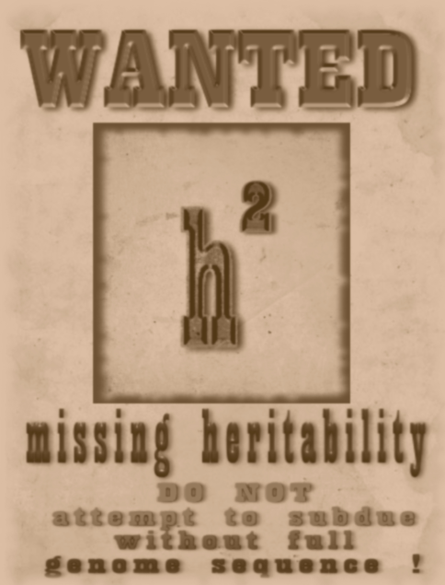
Explaining Missing Heritability in Autism
What have previous studies missed?
Cis-Regulatory Elements
Method
Class of Variant
Limitations
Cytogentics
Structural variants
>10Mb
Copy Number Variants
Common SNPs
10kb – 10Mb
Not enough power for common association
Microarrays
Limited to target.
Imprecise breakpoints
Targeted Sequencing
(Exomes)
Copy Number Variants
SNPs + INDELs

Slide 13
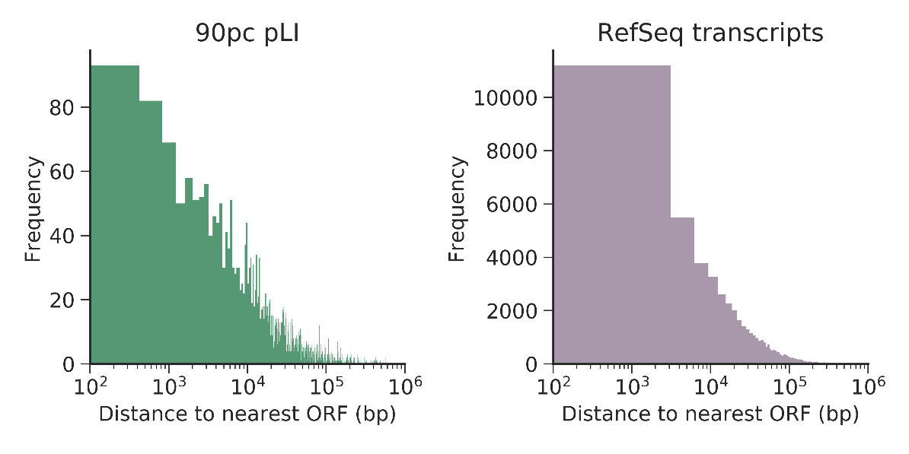
Accounting for Missing Heritability
Exome sequencing neglects cis-regulatory elements
Promoters
UTRs
Transcription Start Sites
*
TSS
Are Cis-Regulatory Structural Variants (CRE-SV) associated with Autism?
*
*
*
Promoter
5’UTR
exon
3’UTR
Microarrays cannot resolve smaller structural variants (50bp-10kb)
37% of non-overlapping open reading frames are within 10kb of each other
pLI: probability that a given gene is intolerant to loss of function mutations (ExAC).
Notes:
Lesson descriptions should be brief.

Slide 14
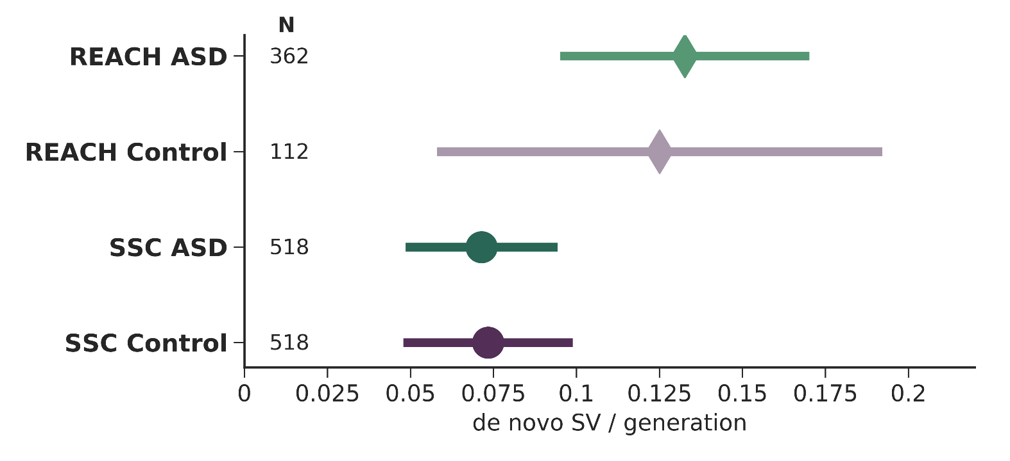
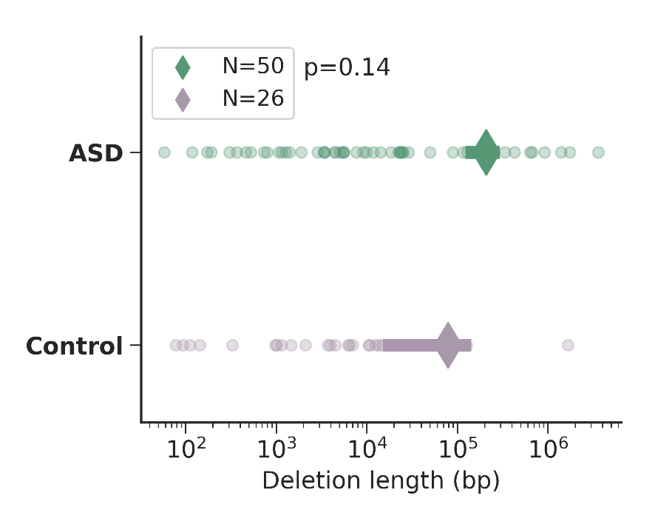
Searching for CRE-SVs in 3,169 whole genomes
829 familes
880 ASD offspring
630 Control siblings
2 Cohorts
REACH: local sources ASD patients (Rady Children’s Hospital, 311 families)
Simons Simplex Consortium (518 families)
Screened negative for de novo LoF or large SV
No de novo CRE-SV detected
Notes:
Example objectives
At the end of this lesson, you will be able to:
Save files to the team Web server.
Move files to different locations on the team Web server.
Share files on the team Web server.

Slide 15
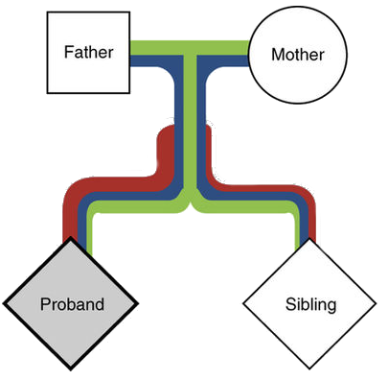

Ascertaining Rare Inherited CRE-SV risk
Group-wise Additive model
Bin variants by functional annotation
Test the transmission rate for binned variants for all offspring in the cohort
Are CRE-SVs transmitted to cases more often than controls?
Transmission Disequilibrium Test (TDT)
Benefits: controls for ancestry and LD
Caveats: genotyping errors confound results
The affected child (proband) inherits more damaging rare mutations (red), than the control sibling.
Adapted from Krumm et al. Nat Gen 2015
Phenotype | Transmitted | Not Transmitted | Transmission Rate
Autism | 2 | 1 | 66%
Control | 1 | 2 | 33%
Notes:
Example objectives
At the end of this lesson, you will be able to:
Save files to the team Web server.
Move files to different locations on the team Web server.
Share files on the team Web server.

Slide 16
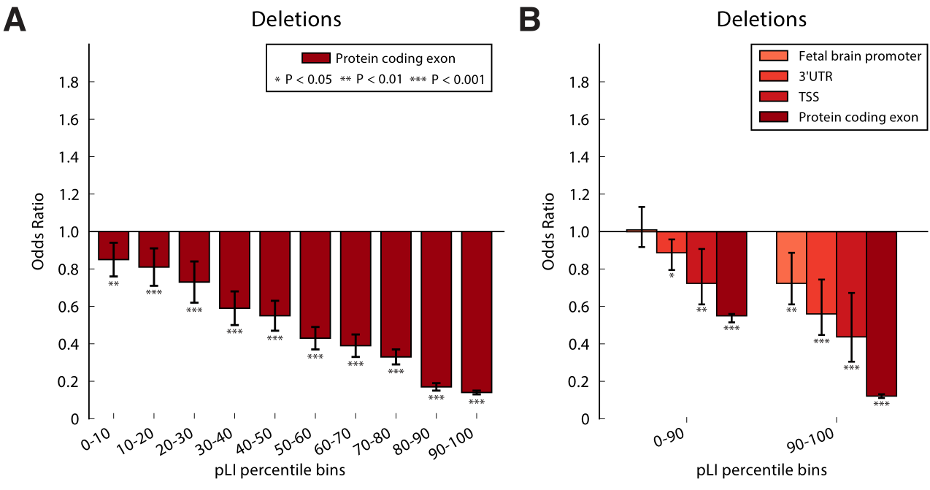
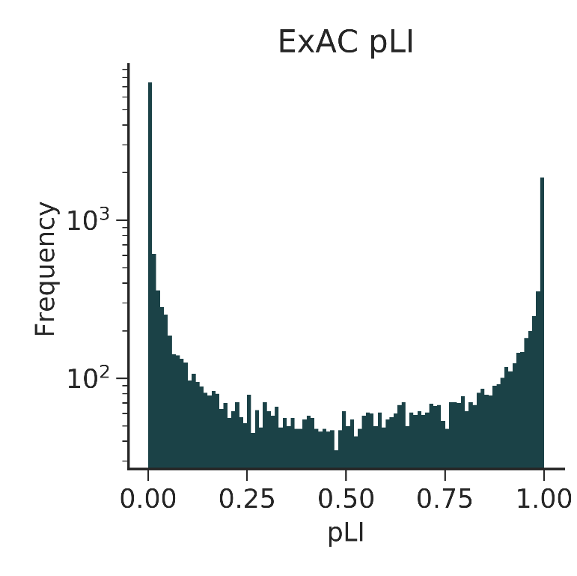
Intolerant Functional Elements are Rarely Deleted
Genes with strong negative selection (pLI >0.9)
Limit to deletions, easier to interpret
Probability of being loss of function intolerant (pLI)
Measure of haploinsufficiency from observed and expected LoFs in Exomes
Functional Constraint
Notes:
Example objectives
At the end of this lesson, you will be able to:
Save files to the team Web server.
Move files to different locations on the team Web server.
Share files on the team Web server.

Slide 17
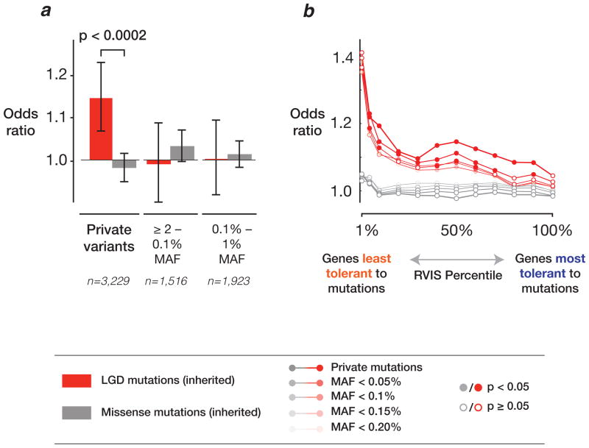
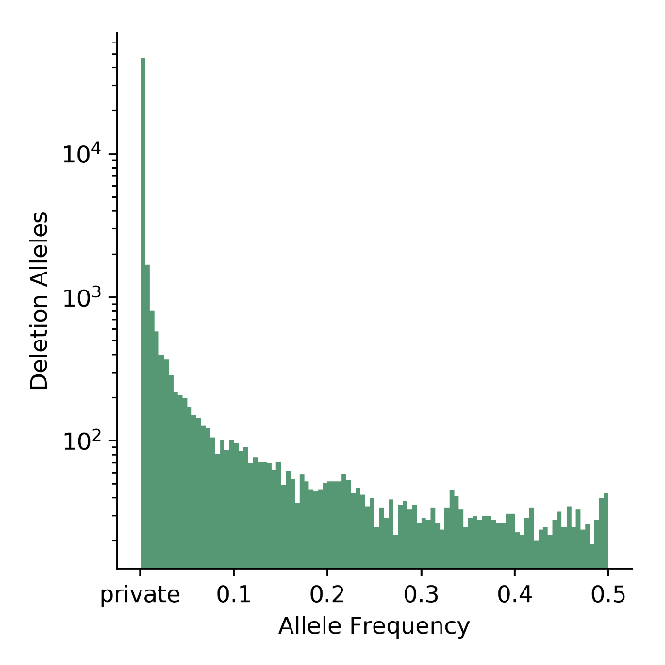
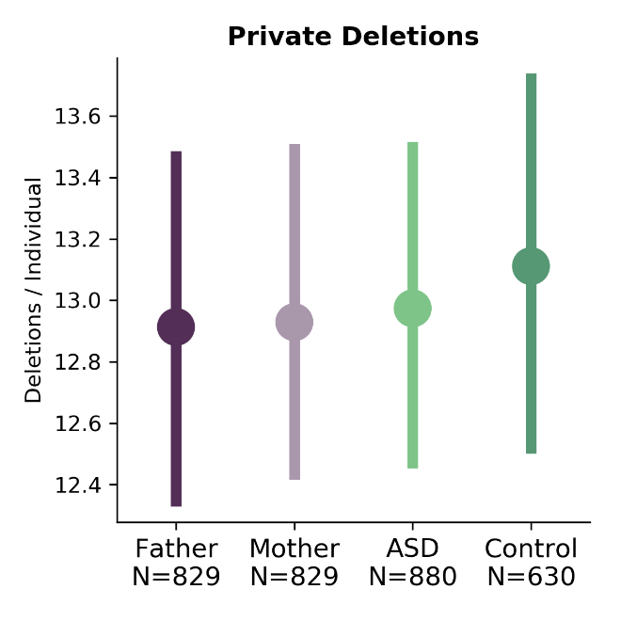
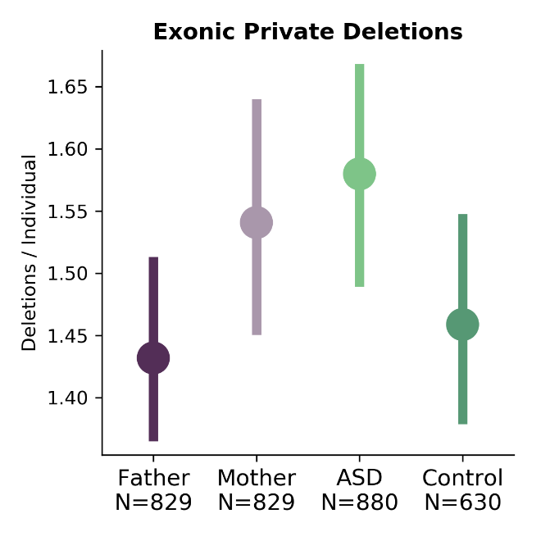
Private Variants are Enriched for Risk
Private variants (singletons) are young mutations
Not enough time for natural selection
LoF
Private loss of function (LoF) SNPs are enriched Autistic children.
Adapted from Krumm et al. Nat Gen 2015
Most variants are rare
More transmission events to test
Cases carry a greater burden of loss of function mutations

Slide 18
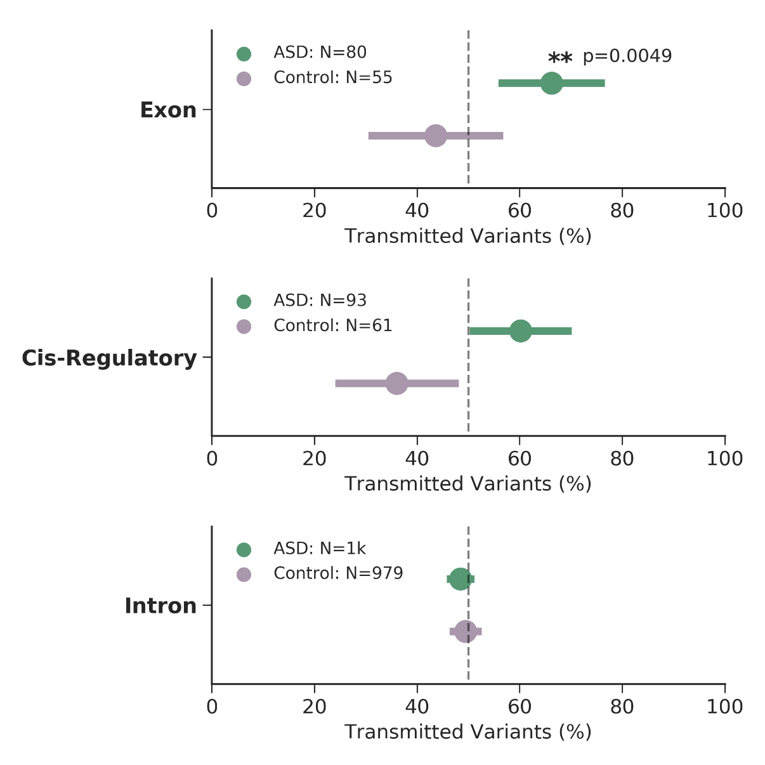

Inheritance of private variants within functionally constrained genes
pLI>0.9908
SVs within introns did not
exhibit transmission bias
Error bars are 95% CI (binomial proportion)
N = number of independent assortment events (transmitted + non-transmitted)
SVs overlapping exons were over-transmitted to cases
Concordant with exome studies
CRE-SVs were slightly over-transmitted to cases
Notes:
Example objectives
At the end of this lesson, you will be able to:
Save files to the team Web server.
Move files to different locations on the team Web server.
Share files on the team Web server.

Slide 19
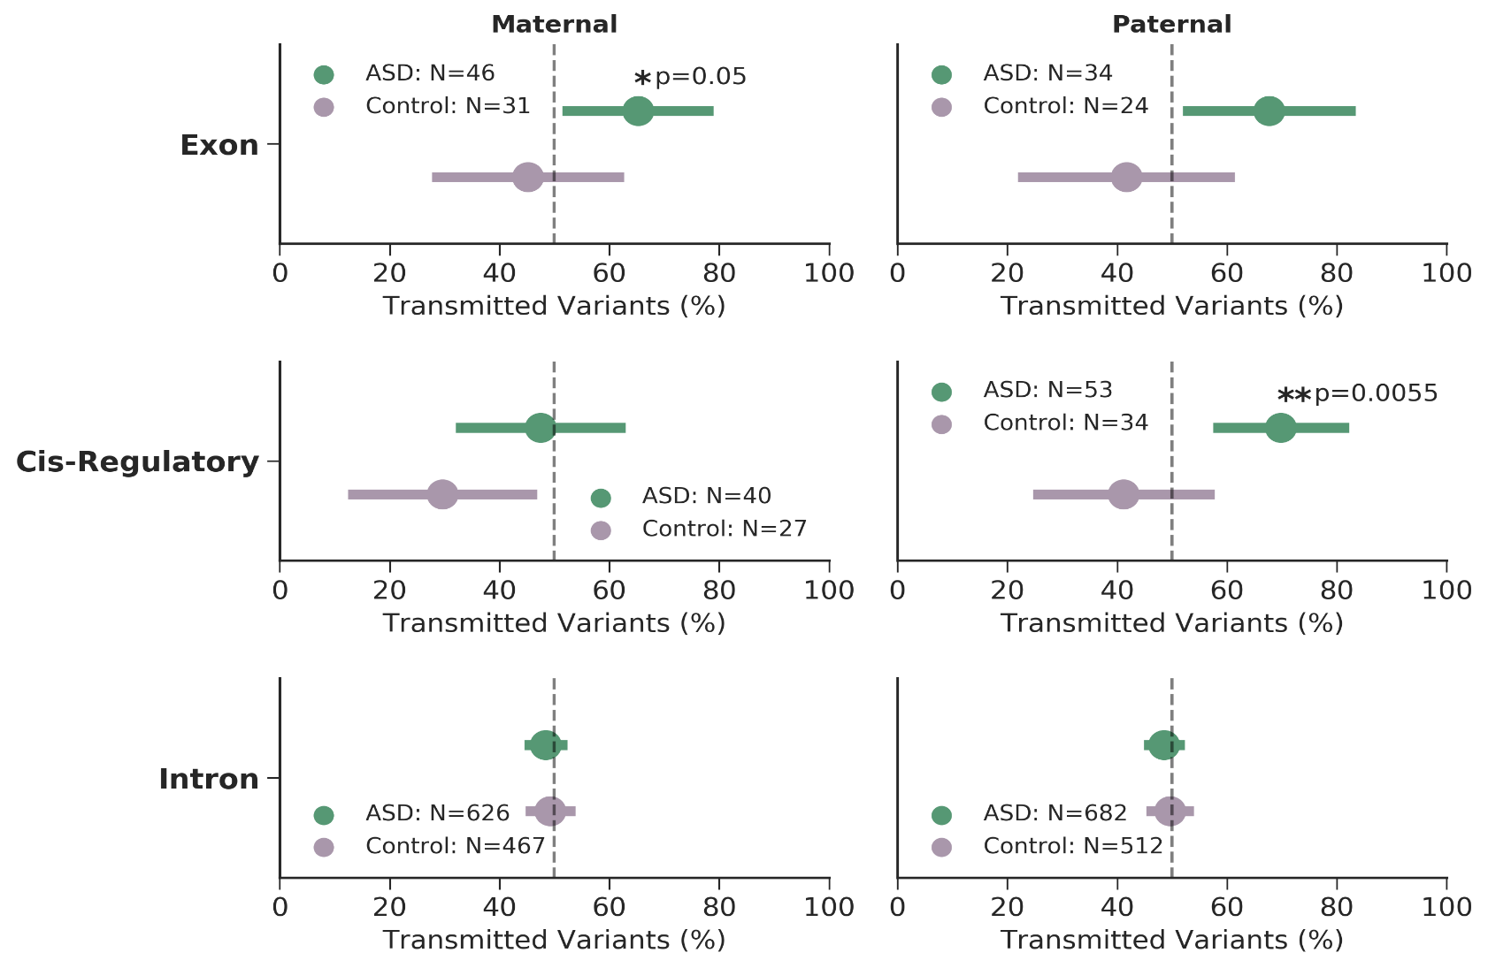
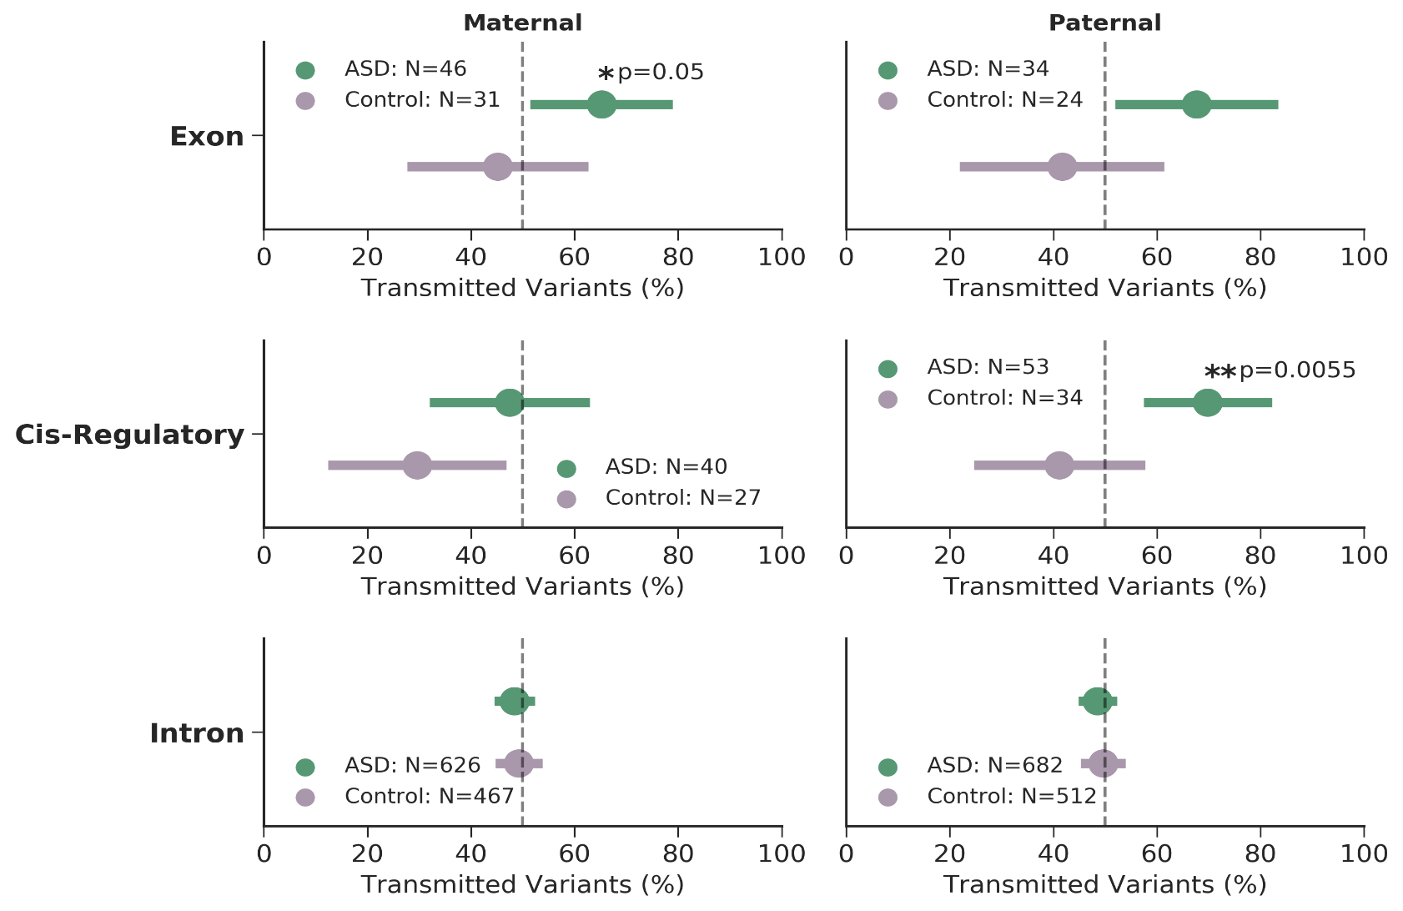

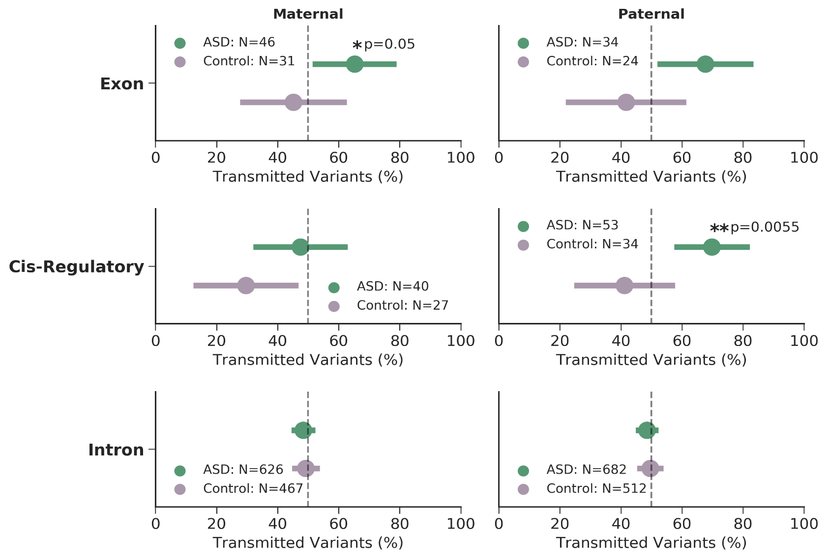
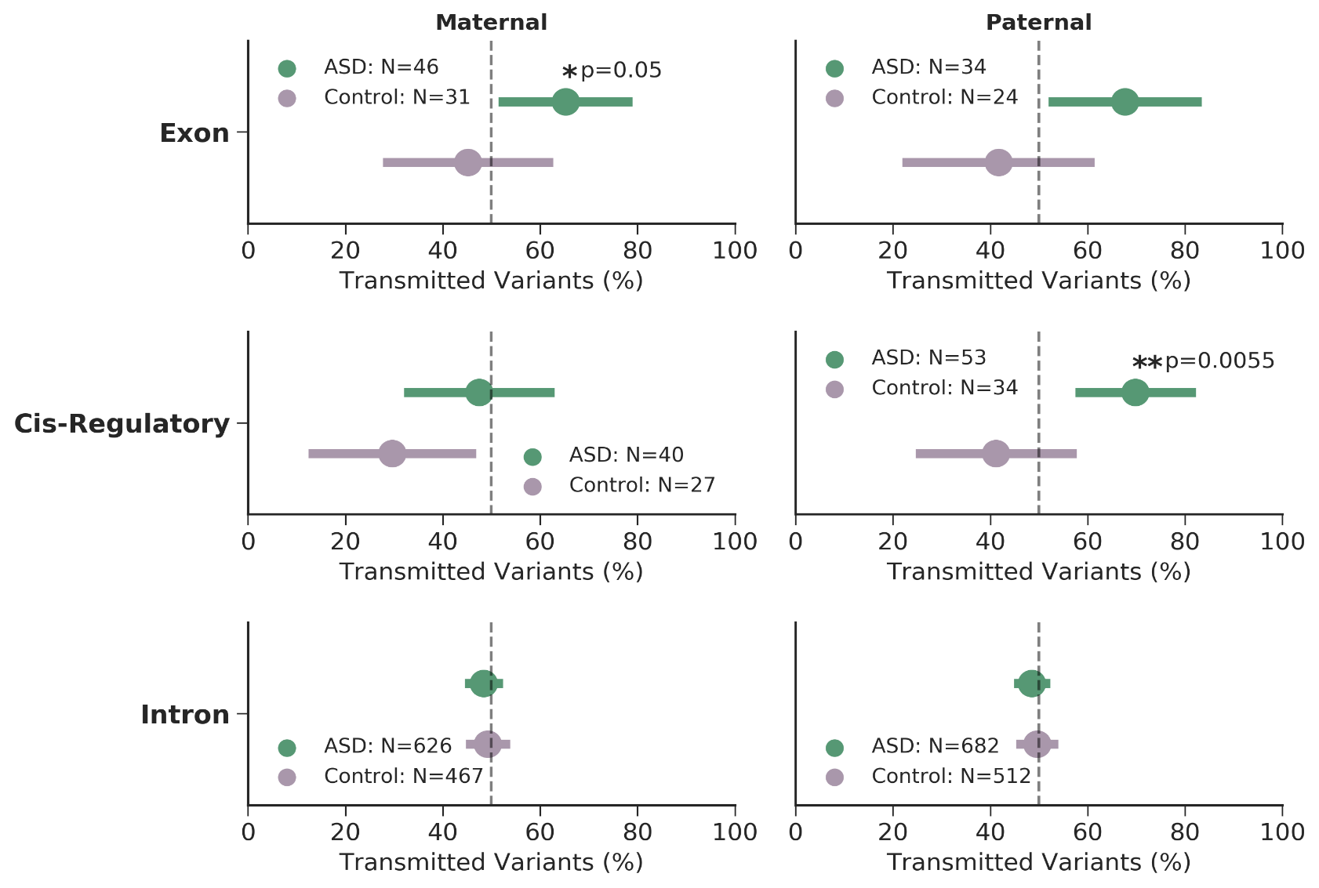
CRE-SVs exhibit a parent of origin effect
pLI>0.9908
No parent of origin effect with private SVs within introns
Mothers over-transmit exonic SVs to cases
Females have higher tolerance for LoF mutations
Fathers over-transmit CRE-SVs to cases
Under-transmission to controls
Notes:
Example objectives
At the end of this lesson, you will be able to:
Save files to the team Web server.
Move files to different locations on the team Web server.
Share files on the team Web server.

Slide 20
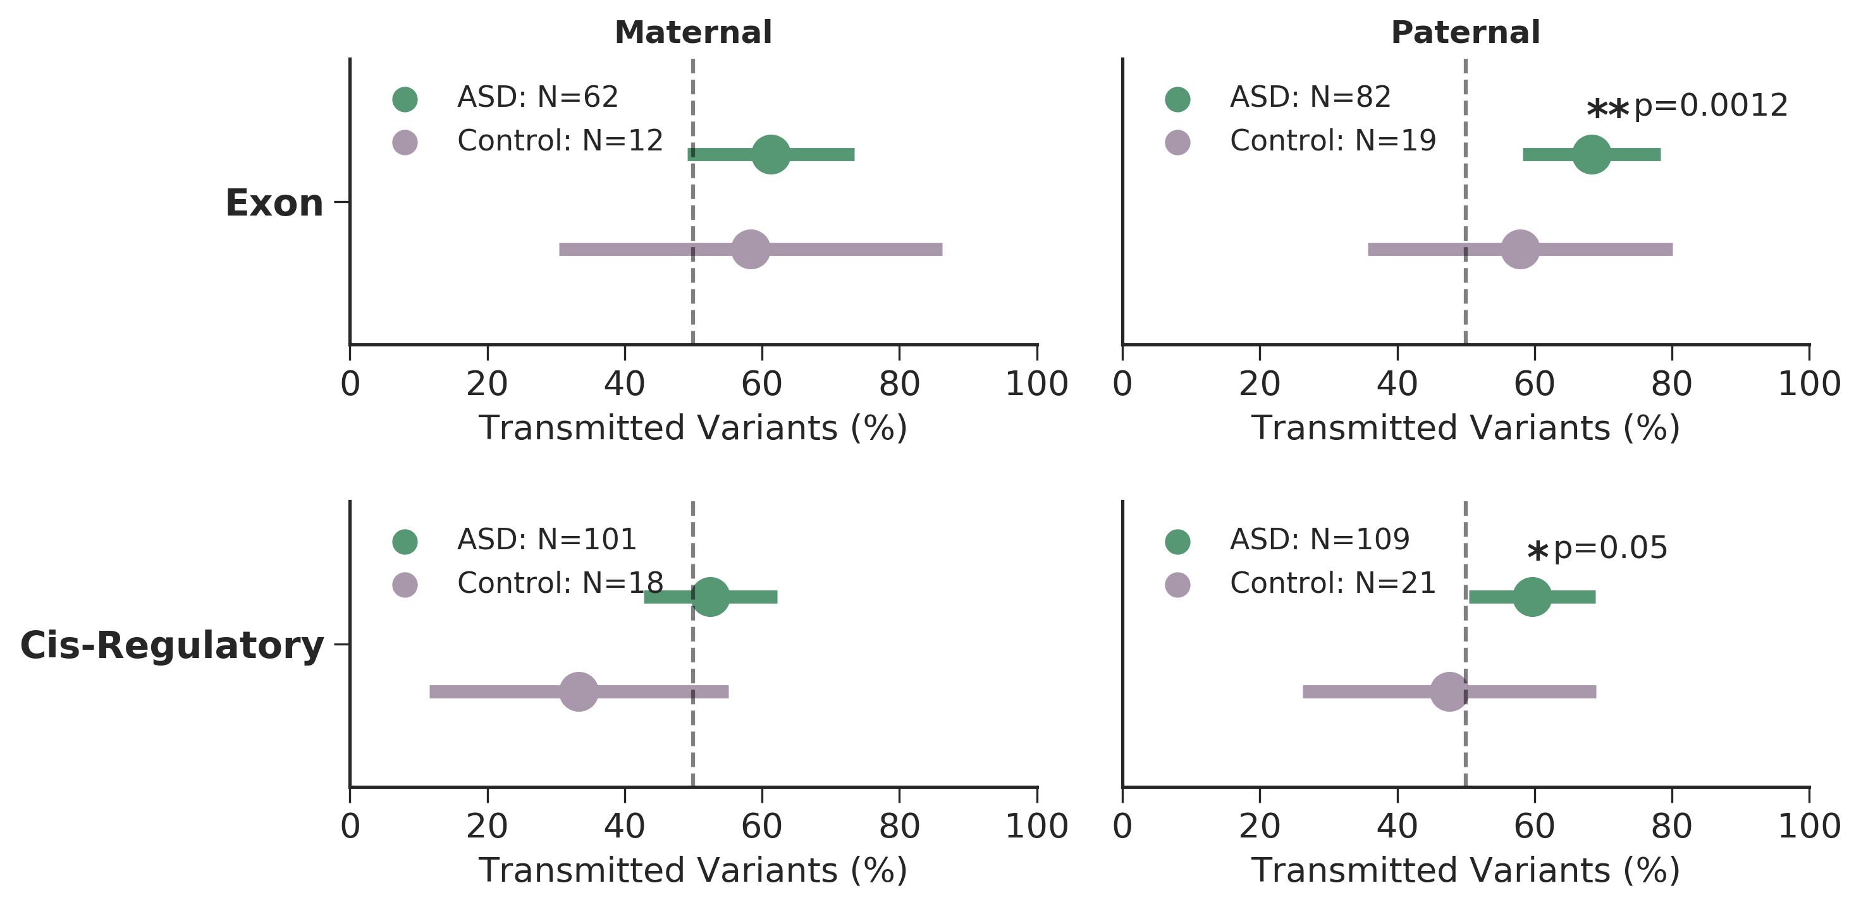
Replicating the parent of origin effect
pLI>0.9908
Collaboration with Stephen Scherer (Toronto)
MSSNG cohort: 3,769 whole genomes
SSC phase 2: 2,336 whole genomes
Exonic SVs are over-transmitted to cases
Fewer assortment events in controls
Modest paternal over-transmission of CRE-SVs to cases
Notes:
Example objectives
At the end of this lesson, you will be able to:
Save files to the team Web server.
Move files to different locations on the team Web server.
Share files on the team Web server.

Slide 21
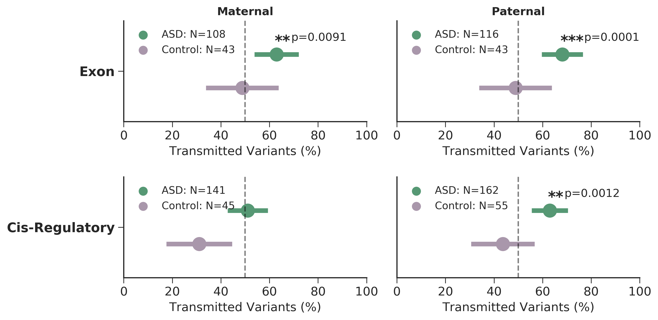
Combining the results
9,274 whole genomes
2,600 families
2,859 cases
1,214 controls
Exonic SVs are over-transmitted to cases
pLI>0.9908
Rare CRE-SVs exhibit a paternal origin effect
Notes:
Example objectives
At the end of this lesson, you will be able to:
Save files to the team Web server.
Move files to different locations on the team Web server.
Share files on the team Web server.

Slide 22
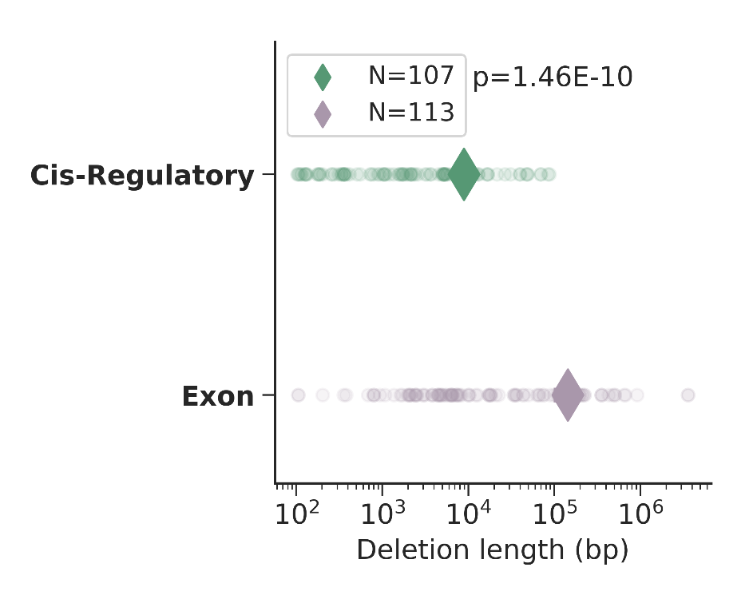
Recurrent CRE-SVs
Gene | Cytoband | Annotation | Syndrome / ASD finding
CNTN4 | 3p26.3-p26.2 | Axon-assoc. cell adhesion molecule | 3p deletion/ASD CNV
RAF1 | 3p25.2 | Proto-oncogene, serine/threonine Kinase | Noonan/ASD CNV
MEST | 7q32.2 | hydrolase activity, paternally expressed | Silver-Russell /7q ASD susceptibility locus
LEO1 | 15q21.2 | Comp. of PAF1 complex, assoc. w/ RNA pol II | ./2 de novo LoF in ASD exome studies
CRE-SVs are significantly smaller than exonic SVs
Notes:
Example objectives
At the end of this lesson, you will be able to:
Save files to the team Web server.
Move files to different locations on the team Web server.
Share files on the team Web server.

Slide 23
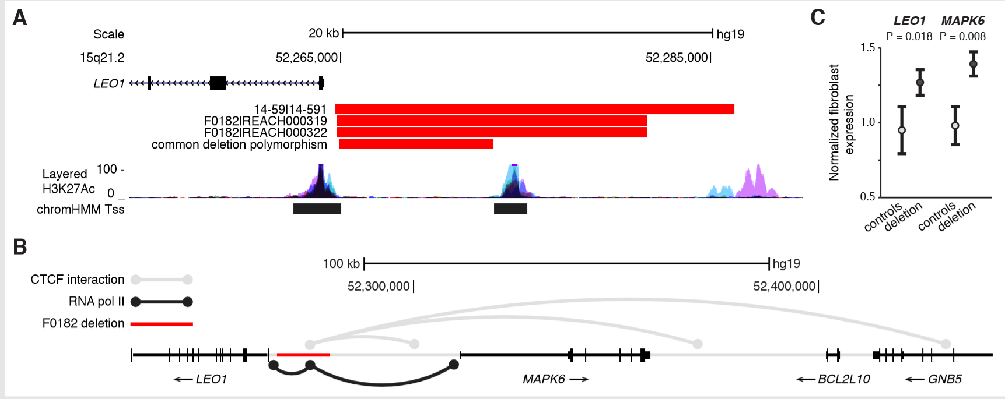
Carriers of the LEO1 CRE-SV had higher expression of LEO1 and MAPK6 in derived fibroblasts
Deletion polymorphism (1.1% AF) does not disrupt any annotated functional elements
ChIA-PET for CTCF and RNA pol II suggest this region is a focal point for long range chromatin interactions
(G.Li et al. Cell 2012) (Z. Tang et al. Cell 2015)

Slide 24


Conclusions and future directions
CRE-SVs exhibit a significant paternal origin effect
~0.8% of cases have a paternally inherited CRE-SV
Rare inherited variants thought to contribute ~3-4% to ASD
Autism is more complex than previously thought
Fathers also contribute inherited risk
Bilineal two-hit model
Inherited maternal LoF of large effect
Inherited paternal CRE-SV of moderate effect
Possible epigenetic mechanism?
Brandler, W.M.*, Antaki, D.*, Gujral, M.*, et al. Paternally inherited cis-regulatory structural variants are associated with autism. Science 2018.

Slide 25
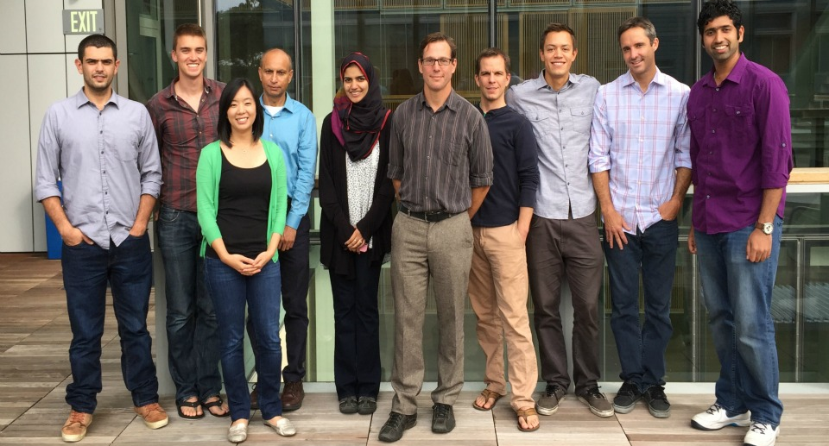
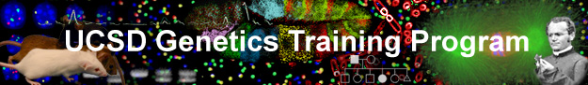
Acknowledgements
Sebat Lab
William Brandler
Madhu Gujral
Prateek Tandon
Oanh Hong
Morgan Kleiber
Tim Chapman
Michelle Maile
Omar Shanta
Adam Koch
Aojie Lian
Stephen Scherer (MSSNG)
Rady Children’s Hospital
REACH project
Human Longevity Institute
Simons Simplex Project
1000 Genomes Project
San Diego Supercomputer Center
Thesis Committee
Jonathan Sebat: chair
Joseph Gleeson
Alysson Muotri
Abraham Palmer
Nicholas Schork
Funding:
NIH predoctoral training grant T32 GM008666 (UCSD Genetics Training Program)
Amazon Web Services Research Grant
Sebat Lab funding:
NIH: MH076431, MH113715
Beyster Family Foundation

